Slide 1
Making this resource work for you
Prior to teaching this lesson, please refer to the ‘Unit Overview and Planning Document’.
Further guidance on planning Science Mastery lessons can be found in the detailed planning guidance document.
Refer to the ‘notes’ section on each slide for useful information, including suggested expositions, pedagogical content knowledge, suggested questions, answers and more. Consider using presenter mode so you can see this guidance throughout the lesson.
The introduction slides can be adapted to suit your teaching style and the needs of your class.
Before the lesson, adapt the fix-it slide to address any misconceptions identified in the previous lesson’s exit ticket.
Choose from the suggested activities to suit your class. The intention is not that you complete all of these, but that you select those which ones are most appropriate for your students. It may be appropriate to further adapt activities for your students.
These lessons are designed to occupy approximately 1 hour. To adapt for a shorter or longer lesson duration we advise you to adapt the activity section accordingly.
Please consider using the final slide to send feedback about this lesson or examples of PowerPoints that you have adapted to our design team. Your feedback is used to improve Science Mastery for all of our teachers and students. We appreciate all suggestions and comments.
Thank you for reading!
The Science Mastery Team

Slide 2
Active Transport
Answer the questions below.
Define diffusion.
Explain what is meant by a concentration gradient.
Describe what happens to a plant cell when placed in a hypertonic solution.
Describe where cells get energy.
Explain what organisms need energy for.
The net movement of particles of a liquid or gas from an area of high concentration to an area of low concentration.
The difference in concentration between two areas.
Water moves out of the cell and it can become flaccid.
From (aerobic) respiration in the mitochondria.
Organisms need energy to carry out life processes, such as growth, reproduction, and movement.
Notes:
Foundation: State the factors that increase the rate of diffusion.
Stretch: A student says that plants only produce oxygen to pass it on to other species. Are they correct?
Answers:
Foundation: Temperature, surface area and concentration gradient
Stretch: incorrect. Plants also need oxygen for respiration as it releases energy for other life processes that they need, such as growth and reproduction.

Slide 3
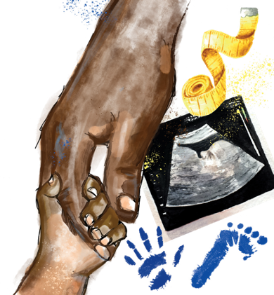
B3.1.11
12/04/2024
Active Transport
B3.1.1 Prior Knowledge Review
B3.1.2 Eukaryotic and Prokaryotic Cells
B3.1.3 Aseptic Technique
B3.1.4 Growth of Bacteria
B3.1.5 Microscopes
B3.1.6 Observing Cells
B3.1.7 Diffusion
B3.1.8 Diffusion in Living Things
B3.1.9 Osmosis
B3.1.10 Osmosis Investigation
B3.1.11 Active Transport
B3.1.12 Cell Division
B3.1.13 Cancer
B3.1.14 Stem Cells
Notes:
Big Idea: Cells are alive
Pupils have been learning about the processes of diffusion and osmosis. In this lesson they will look at active transport and compare the features of active transport with the passive transport processes. Pupils will build on this learning in later units where they will learn how plants use different processes to obtain water and different minerals and the importance of these for the healthy functioning of a plant.
Suggested Hook:
We know that nutrients are absorbed into the blood from the small intestine via diffusion as they travels from a low concentration to a high concentration. But what happens when most of the nutrients have been absorbed and the concentration gradient is zero? Do we lose those important nutrients from the body? No, so let's learn how our body manages to absorb all the important nutrients we eat.

Slide 4

Following this lesson, students will be able to:
Define active transport
Describe the difference between passive and active processes
Explain why active transport is required in the small intestine
Key Words:
active transport
concentration gradient
passive
dilute
concentrated

Slide 5
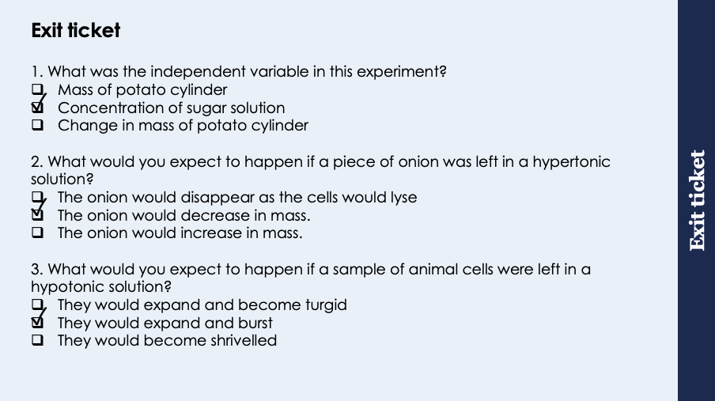
This is the fix-it portion of the lesson
The fix-it is an opportunity to respond to gaps in knowledge, especially those identified by the previous lesson’s exit ticket.
The teacher should customise this slide as needed, to facilitate
reteach, explanation, demonstration or modelling of ideas and concepts that students have not yet grasped or have misunderstood.
practise answering specific questions or of key skills.
redrafting or improving previous work.
Notes:
Purpose: to spend time on gaps identified in previous lesson’s exit ticket.
Answers:
Q1. Answer: B
If pupils have answered incorrectly they have mis-identified variables, A and C both link to the dependent variable in the practical (measure A to find C). To fix this give pupils a selection of independent and dependent variables from experiments and ask them to write an aim for each one.
Q2. Answer: B
If pupils have answered they have misunderstood either the types of solution or the effects of different solutions on plant cells. Answer A indicates that pupils have missed that plant cells have a cell wall so become turgid and do not lyse, answer C indicates not understanding the different solutions. To fix this it could be useful to get pupils to draw diagrams of hypertonic, hypotonic and isotonic solutions for plant and animal cells so they can see which direction the water would move in. It may also be useful to go through plant and animal cell structure to show why animal cells burst, while plant cells become turgid etc. Also useful to give relative concentrations so pupils have to work out whether a solution is hypertonic, hypotonic or isotonic.
Q3. Answer: B
If pupils have answered incorrectly they have misunderstood either the types of solution or the effects of different solutions on animal/ plant cells. Answer A indicates that pupils have missed that animal cells do not have a cell wall so lyse instead of becoming turgid, answer C indicates not understanding the different solutions. To fix this it could be useful to get pupils to draw diagrams of hypertonic, hypotonic and isotonic solutions for plant and animal cells so they can see which direction the water would move in. It may also be useful to go through plant and animal cell structure to show why animal cells burst, while plant cells become turgid etc. Also useful to give relative concentrations so pupils have to work out whether a solution is hypertonic, hypotonic or isotonic.

Slide 6
General Definition
Scientific Definition
Adjective:
Accepting or allowing what others do without active response
Offering no resistance
The movement of substances without requiring energy.
Passive
‘Progress rarely comes as a result of being passive’
Marc Morial
Synonyms
Antonyms
General Examples
Neutral
Patient
Inactive
Teachers get annoyed when students are passive observers in the lesson.
Passive resistance is a method of non-violent protest.
Active
Assertive
Scientific Examples
Diffusion is an example of passive process.
Notes:
Purpose of this slide:
The purpose of the Frayer organiser is to address key scientific vocabulary that students may be familiar with from a non-scientific context. Addressing this at the beginning of the lesson limits the potential cognitive conflict that might arise if students are using their current non-scientific interpretation of a term to understand the science being learned. This approach limits the potential for misconceptions and confusion arising from differing scientific and non-scientific uses of the same word.
The use of this slide is intended to clearly show students
how a word can have both scientific and non-scientific meanings simultaneously
the correct usage of a word in both a scientific and non-scientific context
Teacher guidance:
This slide should be used briefly. Do not dwell on each portion of the slide as this can eat into the lesson quite quickly.
This might be an apt opportunity to ask students to write the scientific definition of the key term into their books. Alternatively, you may want to wait to do this until the term is addressed in more depth later in the lesson.
Suggested narration:
Here we have the word ‘X’. You many already be familiar with this word [display general examples and general definition] in this context. Well, in science, we use this term slightly differently. [display scientific example]. [Display scientific definition]. In science when we use this word what we actually mean is this. You can see that words which mean the same include X,Y and Z. Words that mean the opposite include A, B an C. From this point in the lesson when we refer to this word we’ll be using it in the scientific sense.

Slide 7
Active Transport
Active transport is the movement of substances from a more dilute solution to a more concentrated solution, requiring energy from respiration
Active transport works against the concentration gradient
Notes:
Purpose: introducing new knowledge
Type of exposition: Explanation
Suggested script:
We have learnt that in a passive process such as diffusion and osmosis energy is not needed for the process to take place. The opposite of a passive process is an active process. What do you think an active process means? An active process means that energy is needed for it to take place.
Active transport is an active transport that involves the movement of particles against a concentration gradient. This occurs when particles are moved from a low concentration to a high concentration using energy.
How can we identify that active transport is happening in the diagram? The green substance is moving from a low concentration (2 particles) to a high concentration (6 particles) on the other side. As active transport requires energy to take place, that energy must be used by something. Proteins that are found in the cell membrane (carrier proteins and protein channels) use the energy to carry the substance moving via active transport against the concentration gradient.
Suggested guidance: A model that can be used to explain moving down/against a concentration gradient is to liken it to a slide. Going down a slide requires no energy it will happen naturally (due to gravity) as do both diffusion and osmosis as passive processes that involve moving down a concentration gradient. Climbing up a slide does require energy as the person is moving up against gravity. Likewise moving particles against a concentration gradient requires energy.

Slide 8

Active transport in root hair cells
= Mineral ion
Active transport is used in root hair cells to absorb mineral ions from the soil
Concentration of mineral ions in the soil is lower than inside the cell
Notes:
Purpose: introducing new knowledge
Type of exposition: Explanation
Suggested script:
An example of where active transport it used is in root hair cells. What is the function of a root hair cell? To absorb water and mineral ions from the soil. How is the root hair cell adapted for absorption? It has a long protrusion like structure to increase surface area. We know that water moves via osmosis from a dilute to a more concentrated solution so water moves via osmosis from the soil into the cell. Mineral ions, shown here as red pentagons, in soil are present in a very low concentration. It is essential for the growth of the plant that mineral ions are able to be transported into the root hair cells. The concentration of minerals inside the root hair cells are often higher than the concentration of mineral ions in the soil around. Therefore mineral ions are absorbed into the root hair cell via active transport using energy.
Emphasise that water does not move via active transport, water always moves via osmosis.
Suggestion – draw diagrams to show relative concentrations and ask pupils to judge when diffusion/active transport would take place

Slide 9
Active transport in the small intestine
= Glucose
Active transport is used in the villi in the small intestine to transport glucose from the inside of the small intestine into blood vessels.
This takes place when the concentration of glucose in the small intestine is lower than the concentration of glucose in the blood.
When the concentration of glucose in the small intestine is higher than in the blood (such as soon after eating), glucose travels to the blood through diffusion.
Notes:
Purpose: introducing new knowledge
Type of exposition: Explanation
Suggested script:
The small intestine is adapted to absorb digested nutrient molecules into the blood. How is the SI adapted for transport of molecules? It is adapted for transport of molecules because it has a large surface area (villi), thin walls giving a short diffusion path and villi (and microvilli) which increase the surface area. (microvilli are not shown on this diagram, here are three villi and if we magnified this area you would find 1000s of microvilli)
In this diagram, there is a greater concentration of glucose in the blood as compared to the intestine, shown here by blue hexagons. This means to get the essential glucose particles into the blood where it will be transported around the body to be used in respiration, active transport must be used. This is another example of active transport being used to transport particles against their concentration gradient. Would active transport still happen to transport glucose into the blood if you had just eaten a meal? If there was so much glucose in the intestine after a meal that the concentration was greater than in the blood, then it would travel by diffusion into blood.
Suggested video link: https://www.youtube.com/watch?v=AxXN-j6UzOY
Suggestion – draw diagrams to show relative concentrations and ask pupils to judge when diffusion/active transport would take place

Slide 10

Can you explain the difference between these two terms?
Active transport
Diffusion
Notes:
Suggested guidance: Ask students to discuss in their pairs the difference between these two terms
Ask for a few students to feedback – you are looking for difference in terms of concentration gradient and difference between active and passive processes. You may also want them to include examples.
This could be moved between slides 6&7 instead to cfu definitions before giving AT examples
Suggested guidance:
Talk tasks can be used in a variety of ways to suit the particular needs of the students you are teaching. Through exchanging views with others, students develop their understanding of the science beyond what could be achieved individually.
Science classrooms that successfully integrate talk have the following features:
Science talk is a regular feature of lessons and is woven into classroom activities.
Students are paired or grouped strategically by the teacher to ensure productive interaction. This might take into consideration the students’ proficiency of the English language, how encouraging they might be to peers and their attainment in the topic. It’s a good idea to consider these pairings in the class seating plan.
Students are encouraged and supported to talk, but are not forced to talk.
The teacher should take on the role of a facilitator, engaging with conversations where necessary and encouraging or steering the conversation where needed.
Students are encouraged to use the language they have to express their ideas (e.g., everyday language, imperfect English, native language), but also to incorporate science specific terminology where this is more accurate or has been taught.
6. Scientifically inaccurate ideas are not dismissed by the partner or teacher; open discussion and further investigation are relied on to help students construct ideas that support them to progress in their scientific understanding.
7. Guidelines for behaviour during talk tasks are explicit and frequently reviewed. Rules for students might be:
Listen carefully to your partner
Take turns talking.
Speak one at a time, without interrupting.
Politely agree or disagree and explain why.
Politely point out if your partner has used a scientific word incorrectly, if they have explained the science incorrectly, or if there is a more accurate way to describe something.
If confused, ask questions.
Stay focused on the discussion topic.
Respond to one another.

Slide 11
Quick Quiz
Choose the correct answer for each question:
Active transport occurs when…
A. molecules move in the direction of the concentration gradient
B. molecules move in the opposite direction of the concentration gradient
C. there is no concentration gradient
Active transport is required in the small intestine when…
A. the concentration of glucose is higher in the bloodstream than the small intestine
B. the concentration of glucose is higher in the small intestine than the bloodstream
C. the concentration of oxygen is higher in the small intestine than the bloodstream
Which best explains the difference between diffusion and active transport?
A. Active transport requires energy from respiration but diffusion does not
B. Active transport occurs in the direction of the concentration gradient but diffusion does not
C. Active transport is the movement of water molecules, diffusion is the movement of all solute molecules
✓
✓
✓
Notes:
Purpose: assess understanding of new information and key prior knowledge. Get students to hold up number of fingers for their chosen answer. Take consensus with answers and use questioning to explain why these are the answers and why other answers are incorrect.

Slide 12
Drill
Define active transport
Where in a plant does active transport take place?
Where in the human digestive system does active transport take place?
Is diffusion the movement of particles down or against the concentration gradient?
Is active transport the movement of molecules down or against the concentration gradient?
Which cellular process provides the energy required for active transport to take place?
Notes:
Purpose: This is a knowledge drill. The purpose of this is to check that the critical knowledge is secure before pupils move onto independent practice.
Suggested guidance: There are a range of ways this could be done depending on time and ability range of the class:
Mini whiteboards
As full sentences in exercise books
As short answers in exercise books
In the pupil workbook
As pair talk
As cold call

Slide 13
Drill answers
Active transport is the movement of substances from a more dilute solution to a more concentrated solution, requiring energy from respiration
In the root hair cells
The small intestine (villi)
Down the concentration gradient
Against the concentration gradient
Respiration
Notes:
Purpose: This is a knowledge drill. The purpose of this is to check that the critical knowledge is secure before pupils move onto independent practice.
Suggested guidance: There are a range of ways this could be done depending on time and ability range of the class:
Mini whiteboards
As full sentences in exercise books
As short answers in exercise books
In the pupil workbook
As pair talk
As cold call

Slide 14
Comparing diffusion, osmosis and active transport
Passive
Requires energy
Osmosis
Diffusion
High to low concentration
Involves water only
Against the concentration gradient
Keeps plant cells turgid
Movement of particles
How minerals get into root hair cells
Happens in nature
Transport of solutes
How oxygen leaves a leaf
Needs a semi-permeable membrane
Active Transport
Notes:
Either print out this slide or ask students to copy into their books and place the statements into the correct part of the Venn diagram.

Slide 15
Comparing diffusion, osmosis and active transport
Involves water only
Osmosis
Diffusion
How oxygen leaves a leaf
Passive
High to low concentration
Keeps plant cells turgid
Movement of particles
Happens in nature
Needs a semi-permeable membrane
Transport of solutes
Requires energy
Against the concentration gradient
How minerals get into root hair cells
Active Transport

Slide 16

I: Explain using scientific understanding to make something clear or state the reason for something happening
Example question:
To ‘explain’ your answer should:
Begin with a scientific statement.
Use ‘this means that’, ‘because’ or ‘so’ to link your statement to the question.
Explain why root hair cells contain many mitochondria.
Model answer:
Active transport requires energy as molecules are moving against the concentration gradient
Energy comes from respiration, so many mitochondria are needed
Notes:
This slide models the process of answering an explain question.
Firstly, students are presented with a generic explain question, along with a model answer. Students are also given some simple guidance to follow for producing their own describe answer.
The generic question and answer should be used by the teacher to remind students of
the key features of a great answer
how to structure their answer
why the model answer is a good example
Following this, students will be required to apply this process to answer their own explain question, which will appear in place of the generic questions. This explain question will be specific to the topic students are learning about in the lesson. Give students time to write their own answer to this, ensuring that they use the guidance provided. To further scaffold this task for students, it may be appropriate to:
pair students up to write an answer together
list for students the key words you would like them to include in the answer
provide a writing frame or ‘points to include’ for students
A model answer for this question will appear. Teachers should review the model answer with students by referencing the guidance in the green box. For example ‘we can see item 1 in the guidance is to begin with a scientific statement. Notice in the model answer here we have done just that’. Or ‘item 2 in the guidance here says that we should use a linking statement in the answer. Has this been achieved in the model answer? Where can we see this?’.

Slide 17
We: Explain using scientific understanding to make something clear or state the reason for something happening
Example question:
To ‘explain’ your answer should:
Begin with a scientific statement.
Use ‘this means that’, ‘because’ or ‘so’ to link your statement to the question.
Explain why the cells in the small intestine have many mitochondria.
Model answer:
Active transport requires energy as molecules are moving against the concentration gradient
Energy comes from respiration, so many mitochondria are needed
Notes:
This slide models the process of answering an explain question.
Firstly, students are presented with a generic explain question, along with a model answer. Students are also given some simple guidance to follow for producing their own describe answer.
The generic question and answer should be used by the teacher to remind students of
the key features of a great answer
how to structure their answer
why the model answer is a good example
Following this, students will be required to apply this process to answer their own explain question, which will appear in place of the generic questions. This explain question will be specific to the topic students are learning about in the lesson. Give students time to write their own answer to this, ensuring that they use the guidance provided. To further scaffold this task for students, it may be appropriate to:
pair students up to write an answer together
list for students the key words you would like them to include in the answer
provide a writing frame or ‘points to include’ for students
A model answer for this question will appear. Teachers should review the model answer with students by referencing the guidance in the green box. For example ‘we can see item 1 in the guidance is to begin with a scientific statement. Notice in the model answer here we have done just that’. Or ‘item 2 in the guidance here says that we should use a linking statement in the answer. Has this been achieved in the model answer? Where can we see this?’.

Slide 18
You: Explain using scientific understanding to make something clear or state the reason for something happening
Example question:
To ‘explain’ your answer should:
Begin with a scientific statement.
Use ‘this means that’, ‘because’ or ‘so’ to link your statement to the question.
Explain why the concentration of oxygen in the cells in the small intestine can affect the rate of active transport of glucose into the blood.
Model answer:
Active transport requires energy as molecules are moving against the concentration gradient
Energy comes from respiration which requires oxygen, so the greater the oxygen concentration present, the greater the rate of respiration
Notes:
This slide models the process of answering an explain question.
Firstly, students are presented with a generic explain question, along with a model answer. Students are also given some simple guidance to follow for producing their own describe answer.
The generic question and answer should be used by the teacher to remind students of
the key features of a great answer
how to structure their answer
why the model answer is a good example
Following this, students will be required to apply this process to answer their own explain question, which will appear in place of the generic questions. This explain question will be specific to the topic students are learning about in the lesson. Give students time to write their own answer to this, ensuring that they use the guidance provided. To further scaffold this task for students, it may be appropriate to:
pair students up to write an answer together
list for students the key words you would like them to include in the answer
provide a writing frame or ‘points to include’ for students
A model answer for this question will appear. Teachers should review the model answer with students by referencing the guidance in the green box. For example ‘we can see item 1 in the guidance is to begin with a scientific statement. Notice in the model answer here we have done just that’. Or ‘item 2 in the guidance here says that we should use a linking statement in the answer. Has this been achieved in the model answer? Where can we see this?’.

Slide 19
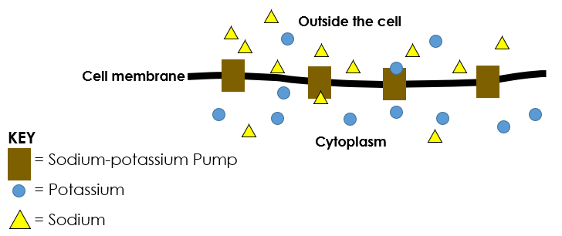
What if…?
Complete the extended response activity
Use full sentences and keywords where necessary
Notes:
Self/peer assessment using possible marking points
Teacher guidance in separate documents including suggested scaffolding
Students should try to write in a concise and scientific way

Slide 20
Answer the questions below.
Active transport is…
A. When molecules go the wrong way round and need energy to give them a push
B. When molecules go from low to high concentration, releasing energy
C. The movement of molecules from low to high concentration, requiring energy
2. When would active transport take place?
A. When a person has eaten a couple of hours ago and has lots of glucose in their gut
B. When a plant takes in important minerals for growth through the soil
C. When a plant takes in water for photosynthesis
3. Diffusion does not require energy because…
A. Molecules are travelling in the same direction as the concentration gradient
B. Molecules are travelling in the opposite direction to the concentration gradient
C. It is more important that the cell keeps the energy to use in respiration
✓
✓
✓
Notes:
Purpose: to find out if students are able to answer key questions that check for understanding of the new information that have been covered.
Answers:
Q1. Answer: C
If pupils answer A the have not understood the purpose of active transport. If they have answered B they have a misconception around energy being released where is should be used. To fix this ask pupils to write a definition of active transport and explain why te energy is necessary. You could refer beck to the slide and concentration gradient analogy in notes section on slide 7.
Q2. Answer: B
If pupils have answered A they have mistaken diffusion for AT, if they have answered C they have mistaken osmosis for AT. To fix this have pupils write out the definitions of diffusion, osmosis and active transport. They could discuss the ways in which the processes are different from each other.
Q3. Answer: A
If pupils have answered B they may have confused diffusion and AT, if they have answered C they have a misconception around why energy is required in AT but not in diffusion. To fix this get pupils to draw a table with similarities and differences for diffusion and active transport, with examples of each. Highlight the ‘active’ part of AT and emphasise diffusion is passive. You could refer beck to the slide and concentration gradient analogy in notes section on slide 7.

Slide 21
Lesson B3.1.11
What was good about this lesson? | What can we do to improve this lesson?
Send us your feedback by clicking this link
or by emailing sciencemastery@arkonline.org
Thank you!

